Slide 1
LECTURE: 4
Search Strategies

Slide 2
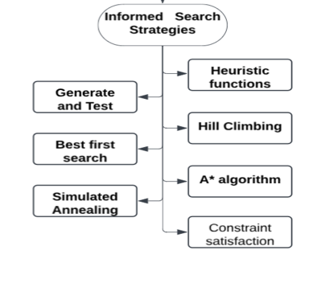
Informed Search Strategies
Informed Search Strategies
Uses heuristics to guide search efficiently.
Leverages problem-specific knowledge for solutions.
Estimates cost or distance to goal.
Reduces search space and computation time.
Ideal for complex, large-scale problems.
Eg: Network Routing, Medical Diagnosis

Slide 3
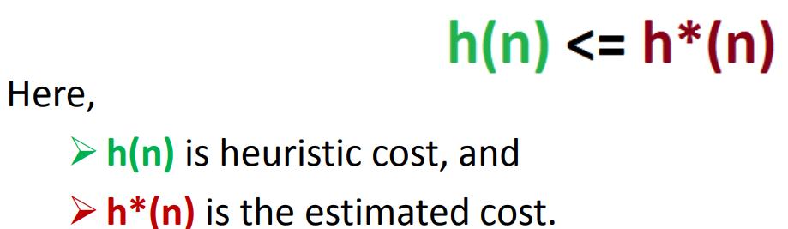
Heuristic functions
Estimates minimal cost from node n
Reduce the search space significantly
Heuristics find good solutions efficiently.
Estimates proximity from current state to goal.
h(n)=Estimated cost from state n to the goal

Slide 4
Heuristic search:
Heuristic search improves search process efficiency.
Sacrifices completeness for better performance.
Heuristics act as problem-solving guides.
Provides good non-optimal solutions quickly.
Handles hard problems in reduced time.
Avoids exponential complexity through heuristics.

Slide 5
Heuristic search
→ Generate-and-test
→ Hill climbing
→ Best-first search
→ Problem reduction
→ Constraint satisfaction

Slide 6
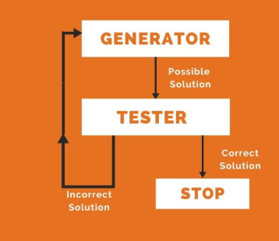
Generate and Test
Generate and Test uses Depth-First Search.
Ensures all solutions are systematically tested.
Known as British Museum Search Algorithm.
Heuristic ranks paths, excludes unlikely ones.
Systematic approach struggles with complex problems.
Combine techniques to reduce search space.

Slide 7
GENERATE-AND-TEST
Acceptable for simple problems.
  Eg : 1. finding key of a 3 digit lock.
      2. 8-puzzle problem
Inefficient for problems with large space.
DFS generates all solutions before testing.

Slide 8
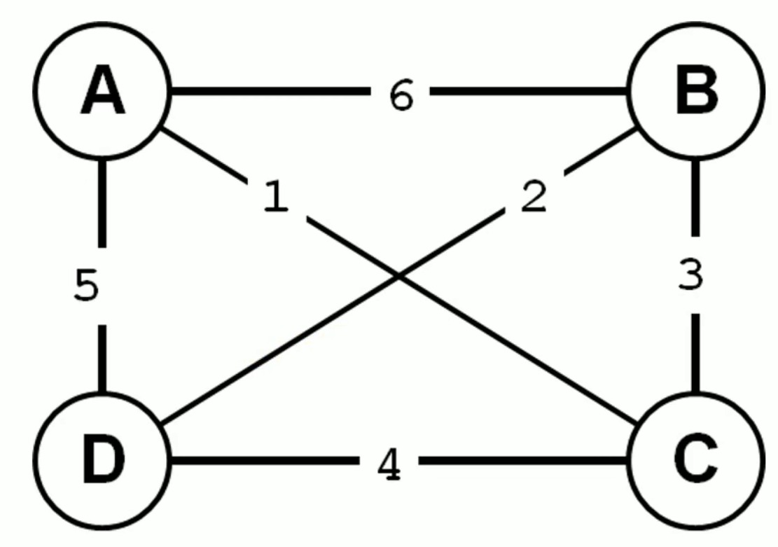
Find optimal solution
Travelling salesman problem -
Travelers need to visit all cities once

Slide 9
Quiz Time
Heuristic function purpose in search:
    a) Eliminates irrelevant nodes.
    b) Estimates cost to the goal.
    c) Guarantees an optimal solution.
    d) Simplifies the search space.

Slide 10
NEXT: Learn about Hill Climbing and its algorithm

